Slide 1
SQL PROJECT ON BOOK SALES
PRESENTED BY :
HARSHITHA D KUMAR

Slide 2
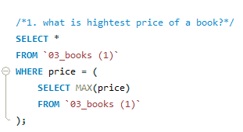
RESULT:

Slide 3
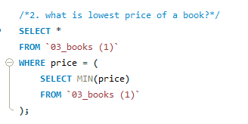
RESULT:

Slide 4


RESULT:

Slide 5
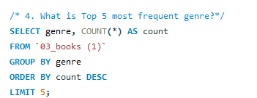
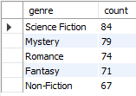
RESULT:

Slide 6
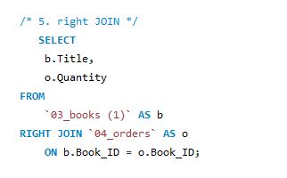
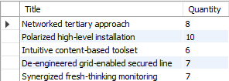
RESULT:

Slide 7
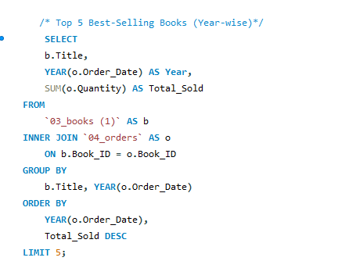

RESULT:

Slide 8
THANK YOU !

